Slide 1
Team Cognitive Training
Improving Quantitative Reasoning by Training
Visuo-Spatial Working Memory
Notes:
Set up:
Math test
Ravens in Direct RT
Block span training

Slide 2

Research Problems
US students underperform
Cognitive ability declines with age
Improve understanding of brain
Working memory as solution

Slide 3

Working Memory
Apply knowledge using general fluid intelligence (gF) to solve problems
gF = short-term memory + working memory (WM)
WM = ability to maintain and manipulate information
WM
Long-term memory

Slide 4
Visuo-Spatial WM
WM = visuo-spatial + auditory + central executive
Visuo-spatial WM ←→ math skills
Train visuo-spatial WM to improve quantitative reasoning

Slide 5
Hypotheses
Cognitive Ability ←→ Quantitative Reasoning
Cognitive Ability Can Be Trained
    Plastic quality of the brain
    Training transfer
Quantitative Reasoning Can Be Improved Through Cognitive Training

Slide 6
Methodology
Recruit Participants
Pre-Test
Training
  Experimental Group: ABST
  Control Group: Sentential
Mid-Point Check-In
Post-Test
Analysis

Slide 7
What We’re Measuring
Response Inhibition
Working Memory
Perceptual Speed
Reading Comprehension
Math Ability

Slide 8
How We’ll Measure It
Adaptive Block Span Task
Raven’s Progressive Matrices
Math Assessment
Modular Arithmetic Task
Verbal Learning Task
Reading Span
Perceptual Speed Tasks
Stroop Task

Slide 9
Status: Completed
IRB
Grant
Task Programming
Plans
  Methodology
  Data Collection
  Data Analysis
Ready for …

Slide 10
Data Collection
Pilot testing this semester
Real testing next semester
Each task has a scoring algorithm.
  Analyze/Compare results from pre and post-tests in respect to training.

Slide 11

Team Composition and Process
6 members
Everyone does equal work
  Ex. All helped program tasks
No subgroups
Work collectively

Slide 12

Advice for Future Teams
Small team is good
  Division of work
  Accountability
  Everyone understands the project
  Easier to coordinate
  Tight knit group

Slide 13
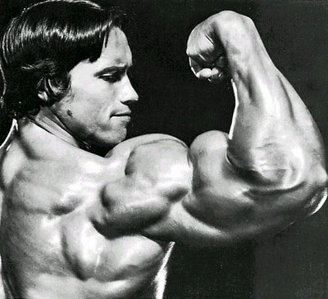
Conclusion
We’re in good shape ☺

